Slide 1
2024 Oka Stream CRD Summary Report
Stop
Customers confidential information under NDA, Intel internal use only
Rev1.0, CQ&R CMEE Team, 2024 Q4

Slide 2
Objectives
Share Findings From CMEE Server Industry Data Collection (Oka Stream Platform Customer Survey)
Data Collected From 7 OEM/ODM Customers/Sites
  Bytedance
  Foxconn Tianjin
  IEIT (Inspur)
  Inventec TW
  Lenovo/LCFC
  Quanta TW
  xFusion

Slide 3
Highlights
Customer common stencil thickness is 5~6mil →
Alpha, Eunow and Shenmao are commonly used paste →
Ersa and Heller are mainstream reflow oven →
Highest peak reflow temperature can up to 250~255C →
4 customers have N2 rework capability →
450ue still the most commonly spec customer can meet →
Most customers direct copy Intel reference board design land pattern →

Slide 4
Solder Paste Print

Slide 5
Solder Paste Printing (1 Of 4)
 | Paste Print Machine | Squeegee Speed | Squeegee Pressure | Stencil Separation Speed
Bytedance/H3C | GKG K870 | 65 mm/sec | 10 +/-3kg | 3 ~10mm/s
Foxconn | GKG Pmax-6 DEK 03IX | 50 +/-10mm/sec | 12 +/-2kg | 0.5mm/s
IEIT L6 (Inspur) | GKG Pmax-8 | 80 +/-30mm/sec | 13 +/-2kg | 0 ~3mm/s
Inventec | Fuji GPX | 20~60 mm/sec | 80 ~ 160N (8.2~16.3kg) | 0.05 ~ 0.6mm/s
Lenovo/LCFC | No Answer | No Answer | No Answer | No Answer
Quanta | Fuji GPX-CII | 45mm/sec | 150N (15.3kg) | 0.2mm/s
xFusion | No Answer | No Answer | No Answer | No Answer

Slide 6
Solder Paste Printing (2 Of 4)
 | Under Screen Cleaning Frequency | Stencil Cleaning Frequency | Cleaning Process | PCB Support Type
Bytedance/H3C | Every 1 PCB | Every 2 hours | Ultrasonic | Vacuum & block
Foxconn | Every 2 PCB | Every 12 hours | Spraying | Support block
IEIT L6 (Inspur) | Every 1 PCB | Every 8 hours | Cleaning paper: Wet wipe & Dry clean & Dry wipe | Support pin, Support block
Inventec | Every 1 ~ 3PCB | No answer | No answer | Dedicate support block
Lenovo/LCFC | No Answer | No Answer | No Answer | No Answer
Quanta | Every 1 PCB | Every 12 hours | Ultrasonic | Dedicate support block
xFusion | Every 1 PCB | Every work order | Ultrasonic | Support pallet
Most customer do under stencil clean after 1~2 prints

Slide 7
Solder Paste Printing (3 Of 4)
 | Do you use the same pallet for paste print, PnP and reflow? | Maximum board handling capability (length x width) | Stencil Technology + coating | Stencil Thickness Used
Bytedance/H3C | Yes | 870 x 610 mm | Laser cut with electro polish + nano coat | 5 mils
Foxconn | No, pallet only for reflow | 850 x 610 mm | FG + laser cut with electro polish | 4 mils
IEIT L6 (Inspur) | Yes | 850 x 610 mm | Electroform, laser cut with electro polish + nano coat | 4 ~ 6 mils
Inventec | No | 21” x 24” (533.4 x 609.6 mm) | FG, laser cut with electro polish + nano coat | 5.91 mils
Lenovo/LCFC | No answer | No answer | FG, laser cut + nano coat | 5 mils
Quanta | Yes | 610 x 610 mm | laser cut with electro polish + nano coat | 6 mils (skt), 4 mils (BGA)
xFusion | Yes | 800 x 800(?) mm | laser cut with electro polish + nano coat | 0.12 mm (~4.7 mils)
Common stencil thickness 5~6 mils

Slide 8
Solder Paste Printing (4 Of 4)
 | Is a step stencil used? | PCB surface finish & thickness | What type of PCB is used? | Solder Paste used
Bytedance/H3C | Yes, base is 0.12mm, with step down to 0.1mm, or step up to 0.15mm、0.18mm | OSP, 118 mils | Type 4 | Murata, Eunow, Tongfang Type 4
Foxconn | No answer | OSP, 62 mils, 98 mils, 118 mils | Type 12 (?) | Alpha OM338PT, ShenMao PF606-P, Type 4
IEIT L6 (Inspur) | Yes, base 4mils, step up 1-2mils | ENIG & OSP, 1.0~3.8 mm (39 mils ~ 150 mils) | No answer | ShenMao, Alpha, Eunow Type 4
Inventec | Yes | OSP, 100 mils | No answer | Type 4
Lenovo/LCFC | Generally, it is about at least 0.5mm greater than or equal to the area where the part is located. | OSP, 62 ~ 118 mils | No answer | Type 4
Quanta | No answer | Most OSP, some ENIG | Type 4 | ShenMao PF606-P26, Type 4
xFusion | Socket will be step up | No answer | No answer | Type 4
Customer capable of using step stencil; ShenMao, Eunow and Alpha are commonly used pastes

Slide 9
Pick and Placement (PnP)

Slide 10
Pick and placement (1 Of 1)
 | PnP Machine | Nozzle size (LGA socket & Intel component) | Max component size capability (x, y) | Max component weight capability (grams) | Min pitch/ball recognition capability
Bytedance/H3C | Fuji NXT M6 | 20G | 200 x 150 mm | 260 g | 0.3 mm pitch
Foxconn | Panasonic NPM-W2 USI FUZION 2-14 | 20x20mm(NPM 3451) 16.5x16.5mm(FUZION H065) | 150 x 150mm (FUZION) connector: 100(L) x 90mm(W) (NPM) | 300g (NPM) 200g (FUZION) | 0.094/0.118mm(0.94mil camera)(FUZION) 0.234/0.292mm(2.3mil camera) (FUZION) 0.5/0.5(BGA) 0.25(CSP)mm (NPM)
IEIT L6 (Inspur) | Panasonic NPM-W2 | 1005 | L 120 × W 90 mm or L 150 × W 25 mm | 168 g | 0.4 mm
Inventec | No answer | 10~20 mm | 74 x 74 mm(140 x 32) normal 150 x 150mm (option ) | 160 g / 80 g option / normal | 0.4 mm pitch / 10000 balls
Lenovo/LCFC | No answer | 24 mm(outside) / 21.5 mm (inside) | 200 x 110 mm | 160 g | 0.1 mm
Quanta | Fuji AIMAX3 | 20 mm | 135 x 135 mm | 250 g | Min 0.8 mm in mess production. Machine capable smaller
xFusion | No answer | No answer | No answer | No answer | No answer
Main PnP machines are Fuji and Panasonic

Slide 11
Reflow

Slide 12
Reflow (1 Of 3)
 | Reflow Oven | Reflow support | Use N2? | O2 PPM
Bytedance/H3C | Ersa HOTFLOW 3/26XL | Yes | Yes | < 1000 PPM
Foxconn | Ersa HOTFLOW 3/26XL | Yes | Yes | < 1000 PPM
IEIT L6 (Inspur) | Heller 1809exl Ersa HOTFLOW 3/26XL | Yes | Yes | < 500 PPM
Inventec | Heller 1809exl | Yes | Yes | < 1000 PPM
Lenovo/LCFC | Heller 1809exl | Yes (picture) | Yes | No answer
Quanta | Kurtz ersa | No answer | Yes | < 2000 PPM
xFusion | Heller 1809exl | Yes, aluminum pallet | Yes | < 3000 PPM
Ersa and Heller are mainstream reflow oven

Slide 13
Reflow (2 Of 3)
 | Belt Speed | Ramp Rate | Cooling Rate | Peak Temp Range | Time above Liquidus
Bytedance/H3C | 95 cm/min | 2.5 °C/s | 4 °C/s | 230-250 °C | 45-90 seconds
Foxconn | 20-200 cm/min | 0-2.5 °C/s | 1.5 °C/s | 235~255 °C | 60-120 seconds
IEIT L6 (Inspur) | 30-180 cm/min | 1-3 °C/s | 1-3 °C/s | 230-250 °C | 60-90 seconds
Inventec | 78 cm/min | < 3 °C/s | < 2 °C/s | 237-255 °C | 65-115 seconds
Lenovo/LCFC | 80 cm/min | < 3 °C/s | < 2 °C/s | 230-250 °C | 60-90 seconds
Quanta | Depends | 1~3 °C/s | 1~3 °C/s | 235-250 °C | 60-90 seconds
xFusion | No answer | No answer | No answer | No answer | No answer
Highest peak reflow temperature can be up to 250~255C

Slide 14
Reflow (3 Of 3)
 | Soak Temp Range and Time | What is the delta T across the component | What is the number of heating and cooling zones used? | Maximum board handling capability (length x width) | SMT Yield Target
Bytedance/H3C | No answer | 5 °C | 9 ramp, 4 heating/reflow, 4 cooling zones | 1068mm x 610mm | 1000 DPM
Foxconn | Soak Time (145-175℃): 60-120 senonds | < 5 °C | 13 heating/reflow, 4 cooling zones | 680mm x 610mm | No answer
IEIT L6 (Inspur) | 60-120 seconds | < 10 °C | 9 ramp, 4 heating/reflow,4 cooling zones | 850mm x 610 mm | 99.5% (whole process FPY)
Inventec | 55-125 seconds | < 10 °C | 4 ramp, 5 heating, 4 reflow, 4 cooling zones | 534mm x 610mm | No answer
Lenovo/LCFC | 90-120 seconds | < 10 °C | 4 heating & cooling zones | 500mm x 600mm | No answer
Quanta | 90-120 seconds | < 10 °C | 9 ramp, 4 heating/reflow,4 cooling zones | 540mm x 600mm | 98.5% (whole process FPY)
xFusion | No answer | No answer | No answer | 800mm | Depends
600+ mm is the max board width customer can handle

Slide 15
Rework and Others

Slide 16
Rework and Others (1 Of 2)
 | Rework Machine | Peak Temp Range | Time above Liquidus | Soak Temp Range and Time | What size of spot heater do you have/use?
Bytedance/H3C | VJ Summit Lxi | 230-250 °C | No answer | No answer | 125mm x 125 mm
Foxconn | No answer | 235-250 °C | 60-120 seconds | 60-120 seconds | 120mm x 120 mm
IEIT L6 (Inspur) | No answer | 230-250 °C | 60-90 seconds | 60-120 seconds | 76mm x 76mm
Inventec | No answer | 235-250 °C | 60-150 seconds | 60-150 seconds | 480mm x 480mm
Lenovo/LCFC | No answer | 235-250°C | 60-120 seconds | 150-200°C/60-120S | According to part specifications
Quanta | No answer | 235-250 °C | 60-90 seconds | 90-120 seconds | 70mm x 70mm
xFusion | No answer | No answer | No answer | No answer | 50mm x 50mm

Slide 17
Rework and Others (2 Of 2)
 | Rework Paste/Flux | Rework use N2? | Rework Yield Target | Do you have MSL-6 handling BKMs? | What are your FA capabilities? (DnP, XS, etc.). XS size restrictions?
Bytedance/H3C | Murata, Eunow | Yes, O2 < 1000 PPM | 99% | Yes | Yes, XS size < 150mm
Foxconn | No answer | No | No answer | No answer | No answer
IEIT L6 (Inspur) | No answer | Yes | 99.9% | No | Yes
Inventec | No answer | Both | No answer | Yes | DnP, XS, shadow moiré, push-pull
Lenovo/LCFC | No answer | Yes | 95% | Yes | Yes
Quanta | No answer | No | 99.9% | No answer | No answer
xFusion | No answer | No | No answer | No answer | No answer
4 customers have N2 rework capability, 3 customers didn’t provide answer

Slide 18
Automation

Slide 19
Automation (1 Of 1)
 | Do you use automation in your assembly process? | Do you have Full or partial automation during the server assembly process. If partial, which part of the assembly process is automated? | Does the automated test or assembly occur in-line or off-line? | If automation is used, what type of equipment/machines are used? | What is used to pick & place Intel's product or retention components (piece parts) ?
Bytedance/H3C | Yes | Except cable assembly, all others are automated | In line | Robotic arm | vacuum nozzle for socket, gripper for piece parts
Foxconn | No answer | Only auto screw for bolster plate | In line | Auto screw machine | Manual
IEIT L6 (Inspur) | Yes | Auto screw, PCBA pick and place | In line | Self design automation | Gripper
Inventec | Not able to share | Not able to share | Not able to share | Not able to share | Not able to share
Lenovo/LCFC | No | No | In line | No | No
Quanta | Yes | Test – full, Assembly - partial | In line | No answer | Gripper and nozzle
xFusion | Yes | Test – full, Assembly - partial | In line | Auto inspection, auto screw | No answer

Slide 20
Assembly Process

Slide 21
Assembly (1 Of 1)
 | Do you use a fixture for the assembly of the PHM components? If yes, what kind of fixture | Do you follow the MAS for the PHM assembly and torque sequence? | What torque is used for the HS assembly? | What RPM is used for heatsink nut torque driver? | Do you have a lighting requirement for the assembly line?
Bytedance/H3C | Yes, use PHM assembly fixture | Yes | 8 in-lbf | No specification | Yes, follow GB5700
Foxconn | Yes | Yes | 8 in-lbf | 800 rpm | 860~1200 lux
IEIT L6 (Inspur) | Yes | Yes | 8 ~ 10 kgf-cm (6.9 ~ 8.7 in-lbf) | 1000 rpm | 750 lux for assembly 1200 lux for inspection
Inventec | Not able to share | Not able to share | Not able to share | Not able to share | Not able to share
Lenovo/LCFC | Yes | Yes | 8 in-lbf | 1000 rpm | 800 lux
Quanta | Yes | Yes | For LGA4677, we use 8.5 kgf-cm (7.4 in-lbf) | No specification | 600 lux
xFusion | No answer | No answer | 3~6 kgf (6.6~13.2 lbf) | No answer | No answer
8 in-lbf torque is most common used for HS assembly

Slide 22
Others for System Integration

Slide 23
Others for System Integration (1 Of 2)
 | What area of improvement would you like to see? | What heatsink design is used? | Do you have experience with RMHS (remote module heatsink) or ganged heatsinks (2 attached HS)?
Bytedance/H3C | None | Intel reference design | Yes, installed by mechanical arm to ensure flatness
Foxconn | None | Own designed heatsink, liquid cooling | No
IEIT L6 (Inspur) | Hope to improve socket dust cover to be easy install/remove by hand, and reduce bend contact | Use own designed heatsink with optimization, reduced assembly complexity and chance to cause bent contact | Have experience on ganged heatsinks (2 attached HS)
Inventec | Not able to share | Not able to share | Not able to share
Lenovo/LCFC | Hope to improve the flatness of CPU bracket | Intel reference design | No
Quanta | None | EVAC | Yes , the PHM module is designed by Quanta ME team , it will install on CPU and connect with others via cooper pipes, but module is all in one type .
xFusion | Hope to improve socket dust cover to be easy install/remove by hand | Air cooling and cold plate cooling | Yes, RMHS (remote module heatsink)
2 customers hope to improve dust cover design, 1 customer want to improve CPU bracket flatness;
4/7 customers have experience on RMHS or ganged HS

Slide 24
Others for System Integration (2 Of 2)
 | What TIM material is used? | Do you use the Intel designed socket cap removal tool? | Are different products assembled on the same assembly line?
Bytedance/H3C | Thermal grease | Yes | Yes
Foxconn | Thermal grease | No, we use our own designed tool | Yes
IEIT L6 (Inspur) | PTIM, thermal grease, thermal pad | Yes | Yes
Inventec | Not able to share | Not able to share | Not able to share
Lenovo/LCFC | Thermal pad | Yes | Yes
Quanta | Thermal pad | No, we use our own designed tool | For mass production, the product line will be fixed
xFusion | Thermal grease | No answer | Yes

Slide 25
Manufacturing Test Process

Slide 26
Manufacturing Test Process (1 Of 1)
 | Are ICT testers used? If yes, please provide ICT tester model | How many times is assembly test done before thermal solution attach? | How are boards transported between all assembly and test process steps?
Bytedance/H3C | Yes, Teradyne test station LX/LH | 4 (AOI,AXI,ICT,FBT) | Lay flat in a tray.
Foxconn | Yes, Keysight 3070 | 3 (MDA, ICT, BSI), for reworked board, total 6 times | Line conveyor and AGV (Automated Guided Vehicle)
IEIT L6 (Inspur) | Yes, Teradyne TSLX/TSLX2 or flying probe SPEA 4060S2 | 1 (ICT) | Lay flat in a tray, move by cart. picture
Inventec | Not able to share | Not able to share | Not able to share
Lenovo/LCFC | Yes, Agilent 3070, Teradyne, and TRI 5001 | 1 (ICT) | Using a cart, place the motherboard vertically on the cart (or horizontally in a tray)
Quanta | Yes, Keysight | 1 | When the PCB need to be repaired, we use carts to transfer, other we use conveyor. picture
xFusion | Yes | 2 (repair board 4 times) | Cart or tray, lay flat

Slide 27
Board Strain Monitoring

Slide 28
Board Strain Monitoring (1 Of 3)
 | When do you monitor board strain through board assembly, test, and handling steps? | What board strain guidance do you use? | What is the lowest BFI strain that you have been able to meet through board assembly, test, handling steps prior to thermal-solution attach? | How many total process steps (assembly, test, handling) do you monitor board strain on?
Bytedance/H3C | For every project | Follow Intel BFI guidance | < 450ue | 1. ICT test; 2. De-panel; 3. Functional test; 4. Thermal module assembly; 5. System assembly;
Foxconn | For every project | Follow customer request | < 450ue | Same as above
IEIT L6 (Inspur) | For every project | No answer | < 450ue | 1. ICT test; 2. De-panel; 3. Functional test; 4. Thermal module assembly
Inventec | Not able to share | Not able to share | Not able to share | Not able to share
Lenovo/LCFC | For every project, every fixture | Follow Lenovo spec | < 450ue | 1. ICT test; 2. De-panel; 3. Functional test; 4. Thermal module assembly
Quanta | For every project | Follow CPU vendor guidance | < 250ue | 1. ICT test; 3. Functional test; 4. Thermal module assembly; 5. System assembly; - no de-panel
xFusion | No answer | No answer | No answer | No answer
450ue still the most commonly spec customer can meet

Slide 29
Board Strain Monitoring (2 Of 3)
 | Do you collect any solder joint FA (Failure Analysis) after board assembly, test, and handling steps?
 | If yes, what type of tools are used? | If yes, when? | If yes, what is the purpose?
Bytedance/H3C | DnP, XS, X-Ray | For every project | as a pre-step for board or system-level reliability testing
Foxconn | DnP, XS, X-Ray | Follow customer’s test matrix | 1. as a pre-step for board- or system-level reliability testing (e.g. TC or shock) 2. as a board or system assembly time=0 solder joint quality control check
IEIT L6 (Inspur) | DnP, XS, X-Ray | For every project | Follow customer’s request
Inventec | Not able to share | Not able to share | Not able to share
Lenovo/LCFC | DnP, XS | Introduce new project When introduce new material, for example: Skt, DIMM, new PCB material | 1. as a pre-step for board- or system-level reliability testing (e.g. TC or shock) 2. as a board or system assembly time=0 solder joint quality control check
Quanta | DnP, XS | For every project and every stage | Same as above
xFusion | No answer | No answer | No answer

Slide 30
Board Strain Monitoring (3 Of 3)
 | What is the largest BGA package and socket that you can currently manufacture through board assembly, test, and handling steps? | Do you anticipate any challenges controlling board strain as packages grow larger, more rectangular, etc.? | Would you be willing to share BFI strain data that you have collected on an Intel product?
Bytedance/H3C | 125 x 125 mm | Yes, test fixture design and handling will have lower margin | No
Foxconn | 150 x 150 mm | Yes, test fixture design and handling will have lower margin | Yes. We can share one
IEIT L6 (Inspur) | 135 x 135 mm | Yes, 1. solder joint quality (open/short), 2. Lower flatness, 3 hard to rework | Yes
Inventec | Not able to share | Not able to share | Not able to share
Lenovo/LCFC | 200 x 125 mm | Yes, the CPU bracket flatness is hard to control, which will impact strain gauge test | No
Quanta | 70 x 73 mm (in HVM) | Yes | No, it’s customer’s confidential file
xFusion | No answer | No answer | No answer

Slide 31
Socket Land Pattern

Slide 32
Socket Land Pattern(1 Of 1)
 | Do you use Intel’s reference board design archive or the land pattern guidance document to create your CPU socket library symbol? | Do you build your socket symbol with soldermask compensation (soldermask opening larger than metal defined pads), non-compensated (soldermask the same size as metal defined pads), or a combination of both? | How does the usability of the collateral provided by Intel for the physical symbol for server sockets compare to other suppliers of similar sockets? | How are motherboard mounting hole locations determined?
Bytedance/H3C | No answer | A combination of both | No answer | Depend on structure model/drawing to decide mounting hole location
Foxconn | No answer | No answer | No answer | No answer
IEIT L6 (Inspur) | Used & copied Intel’s reference board design with library symbol for socket land pattern | Non-compensated (soldermask the same size as metal defined pads) | Based on the current experience of PR and MDP projects, Intel directly provides library/symbol usage and design guidance documents, which is better for design and development. | Used & copied Intel’s reference board design
Inventec | Not able to share | Not able to share | Not able to share | Not able to share
Lenovo/LCFC | Direct copy from Intel reference brd to create own symbol file | Non-compensated (soldermask the same size as metal defined pads) | Intel’s symbol file is better than competitors’ | Direct copy from Intel reference brd
Quanta | Follow the Intel recommendation | A combination of both | No answer | No answer
xFusion | Copy reference board design for socket land pattern | Copy reference board and improve based own experience | Intel provides more detail information | Skt mounting hole copy Intel, others depend on board stress simulation

Slide 33
Board Reference Design

Slide 34
Board Reference Design(1 Of 1)
 | Do you follow Intel’s reference design closely under Intel components (i.e., under the socket)? 1. Via Type and size 2. Routing and power shapes 3. routing configuration 4. dielectic thickness around high speed signal layers | Do you utilize the PCB materials validated by Intel’s reference design for boards using Intel components? | Is there additional information about manufacturing related aspects of the reference board in areas under Intel components that is needed?
Bytedance/H3C | Yes | We reserve 4 kinds PCB material, and select from them based on SI performance, cost, availability etc. | Hope MAS can be provided earlier
Foxconn | No answer | No answer | No answer
IEIT L6 (Inspur) | Used & copied Intel’s reference board design | Utilize the PCB materials validated by Intel’s reference design. | For board design, used & copied Intel’s reference board design first, requires Intel to provide the official PDG.
Inventec | Not able to share | Not able to share | Not able to share
Lenovo/LCFC | Refer to CRB | Utilize the PCB materials validated by Intel’s reference design | Can Intel provide VIPPO or SKIPVIA methodology and back drill depth?
Quanta | No answer | No answer | No answer
xFusion | Refer to Intel reference design, and perform in depth SI/PI optimization | Depends, we have our own certified PCB material | For big package, the process window is small, hope Intel can provide gen to gen changes of DFM rules, CTE requirements, board thickness, layer to layer alignment requirements etc.

Slide 36
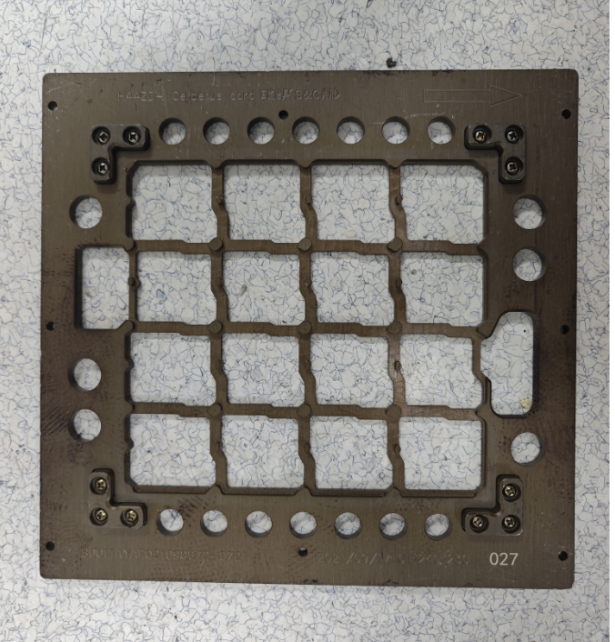
Reflow Pallet
LCFC Reflow Pallet

Slide 37
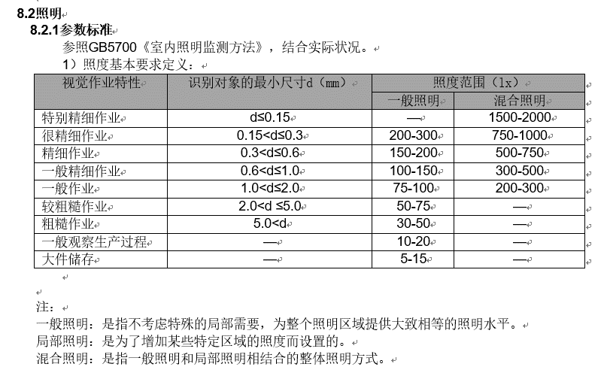
GB5700

Slide 38
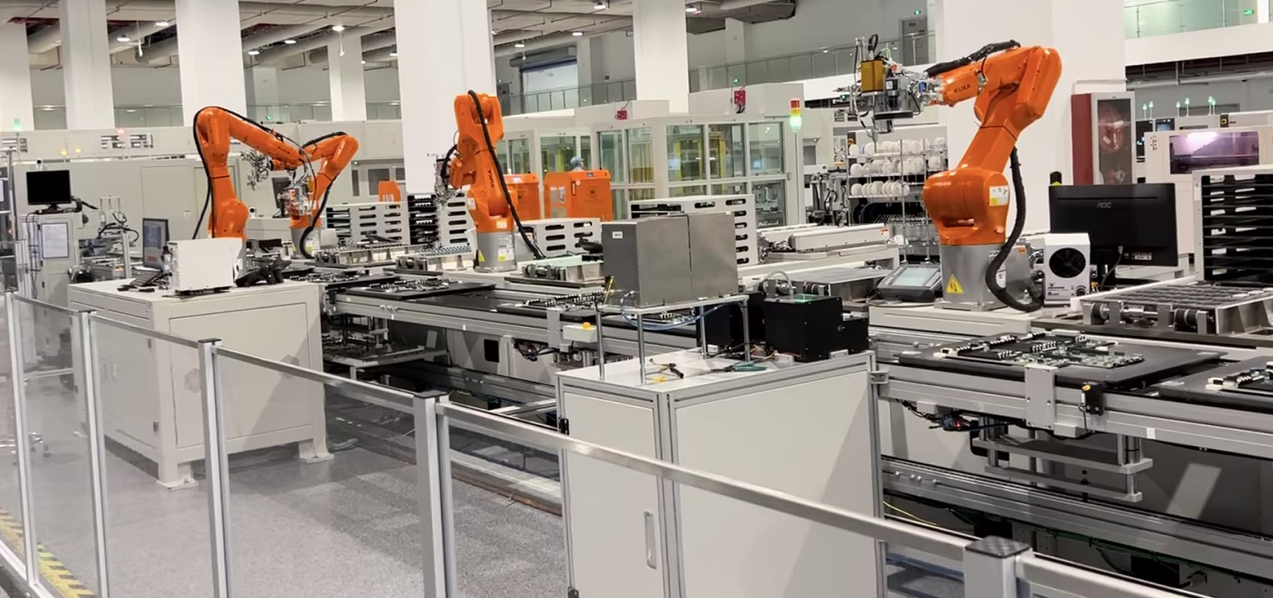
ByteDance ODM Board Transportation

Slide 39
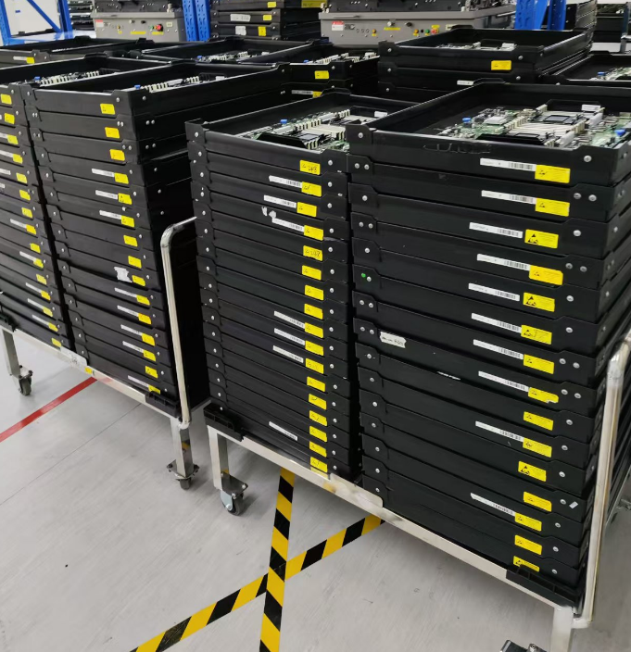
IEIT Board Transportation

Slide 40
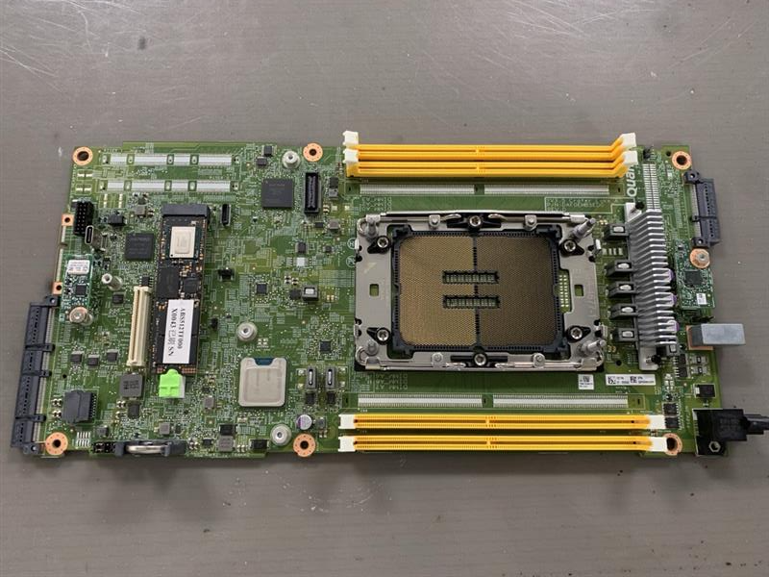
Quanta Board Transportation

